Slide 1

Linear Integrated Circuits EE-411 L1
Dr. Syed Arsalan Jawed
Associate Professor of Practice
Office Hours : W-301, Tuesday/Thursday : 1600-1700
September 02-04, 2025
H-505
!پھربرق فروزاں ہےسر وادی سینا ، اۓدیدہ بینا
The flame of illumination set ablaze…. O’ the beholder of sight!

Slide 2
Quick Review of Week2

Slide 3
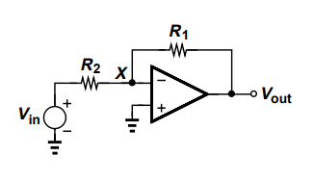
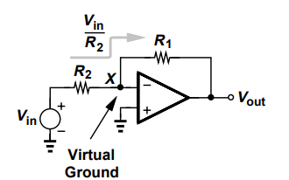
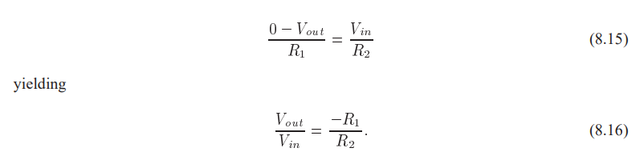
Inverting Amplifier

Slide 4
Issues with Inverting Amplifier
Inverting gain.
Input impedance = R2

Slide 5
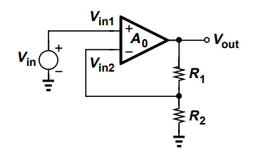
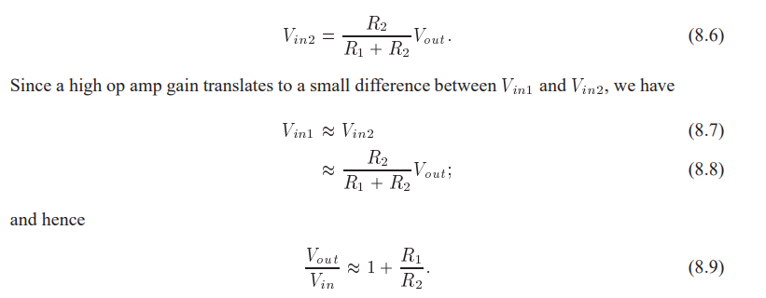
Non Inverting Amplifier
Rin= Infinity
Non inverting gain

Slide 6
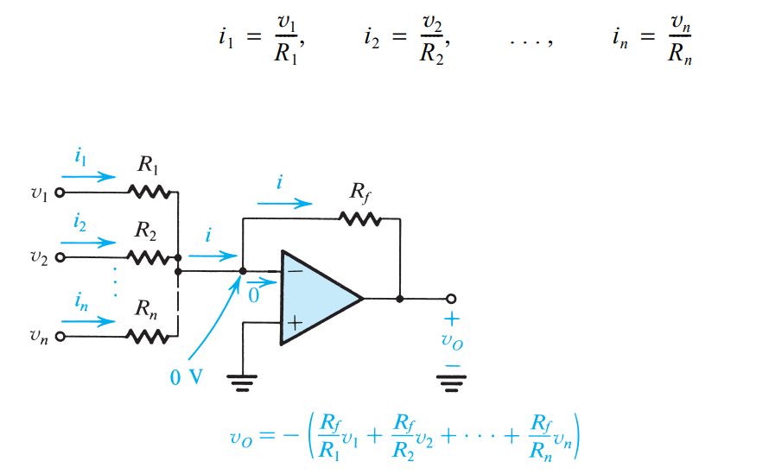
Weighted Summer

Slide 7
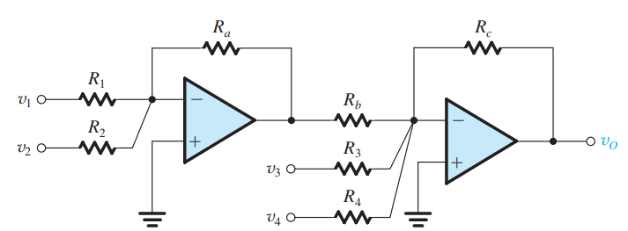

Class Example

Slide 8
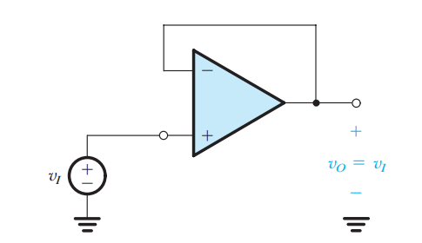

The Voltage Follower

Slide 9
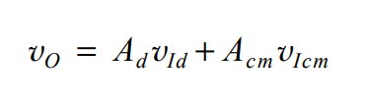

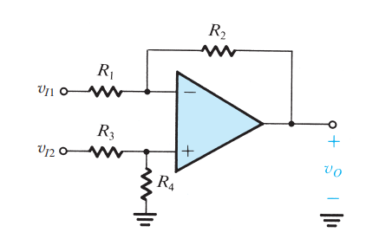




Difference Amplifiers
/home exercise

Slide 10
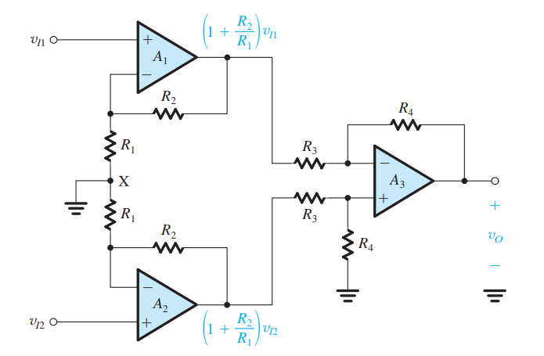

The Instrumentation Amplifier

Slide 11
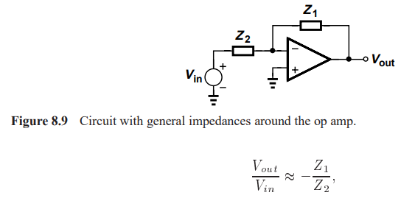
Integrator and Differentiator

Slide 12
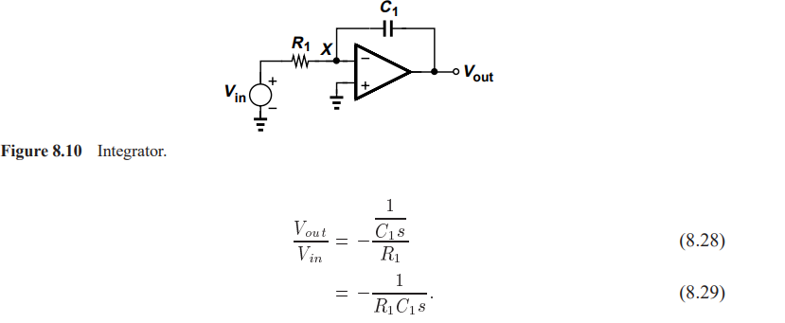
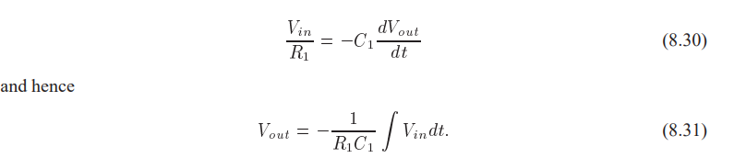
Integrator
Why impractical?

Slide 13
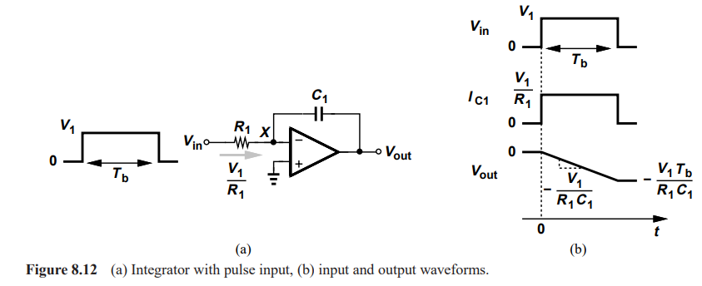

Slide 14
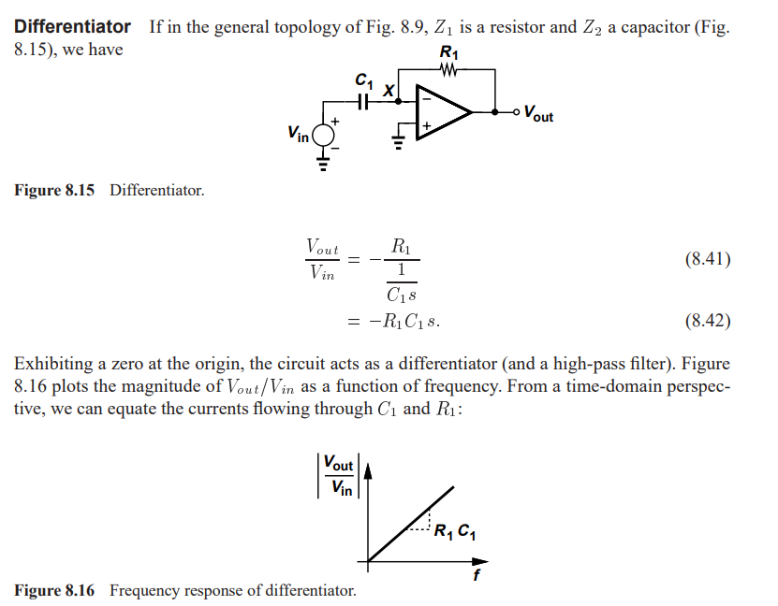
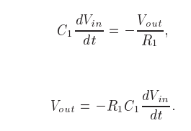
Differentiator

Slide 15
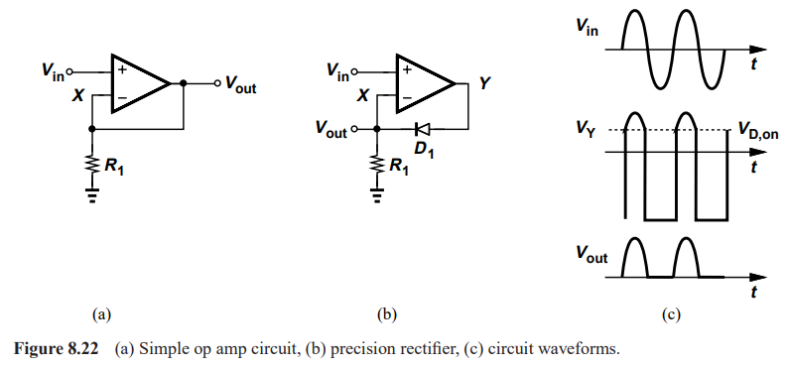
Non Linear Functions – Precision Rectifier

Slide 16
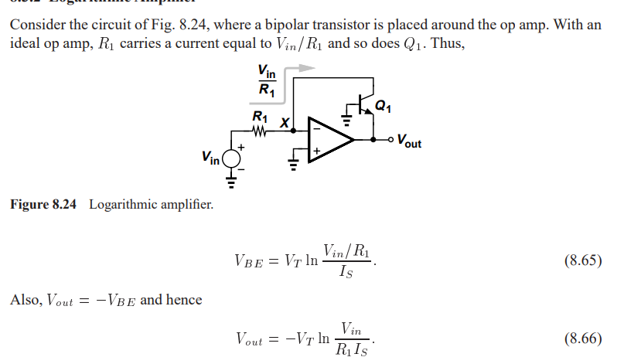
Log Amplifier

Slide 17
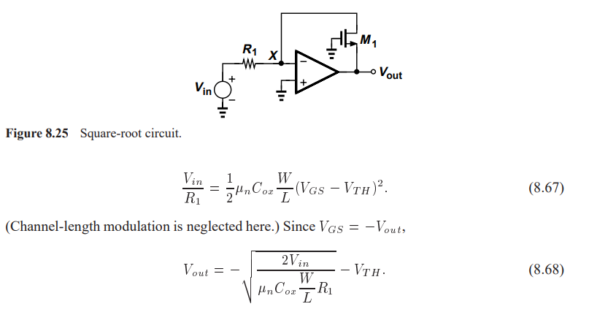
Square Root Amplifier

Slide 18
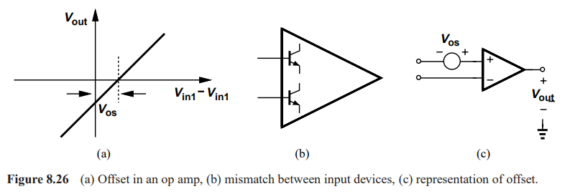
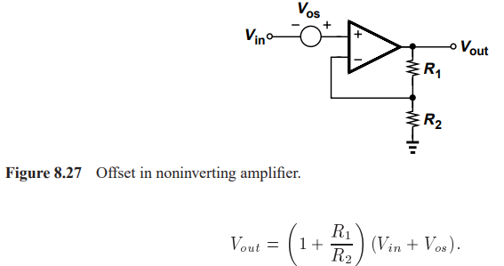
Opamp Non Idealities
DC Offset

Slide 19
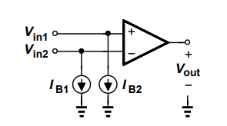
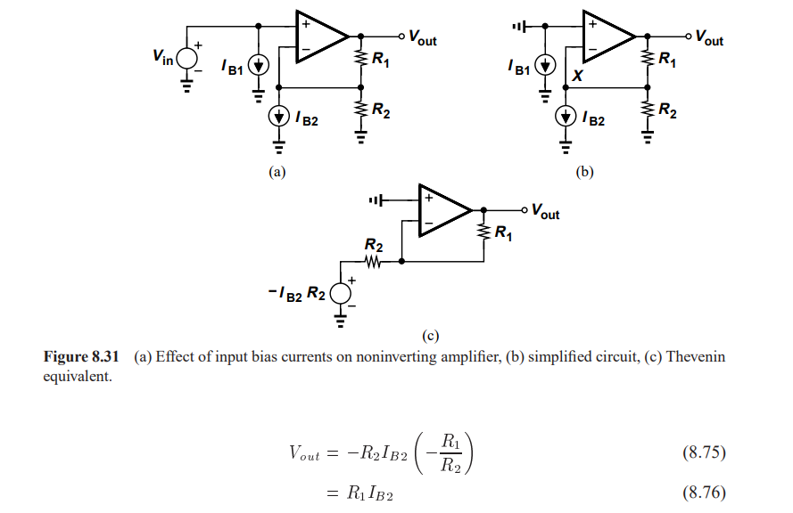
Input Bias Current

Slide 20
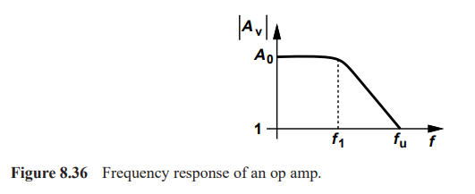
Speed Limitation
Bandwidth

Slide 21
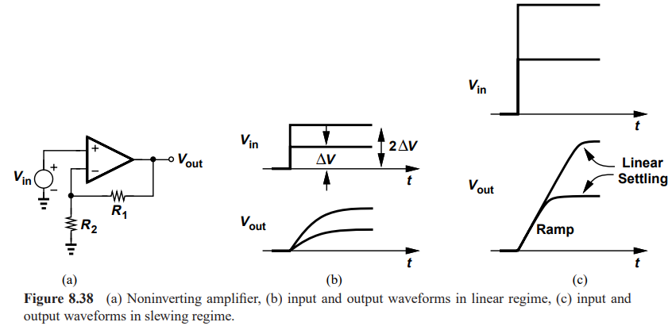
Slew Rate

Slide 22
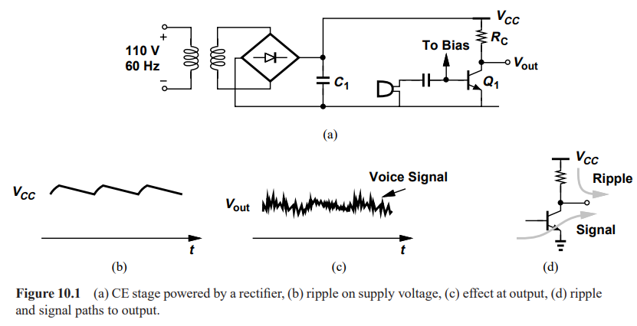
Chapter 10 : Differential Amplifiers

Slide 23
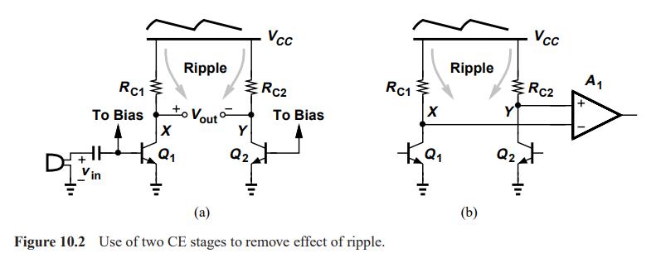

Slide 24
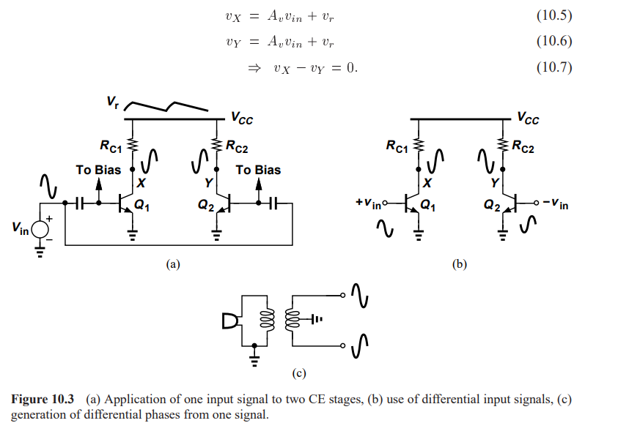
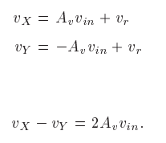
Differential Signals

Slide 25
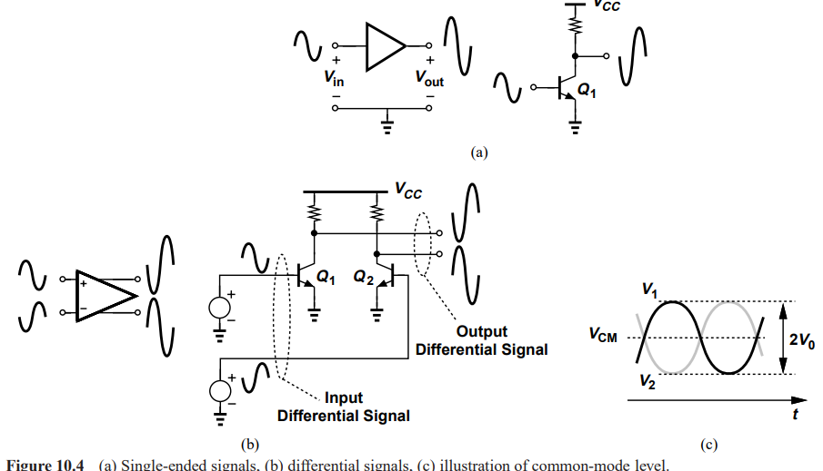

Slide 26
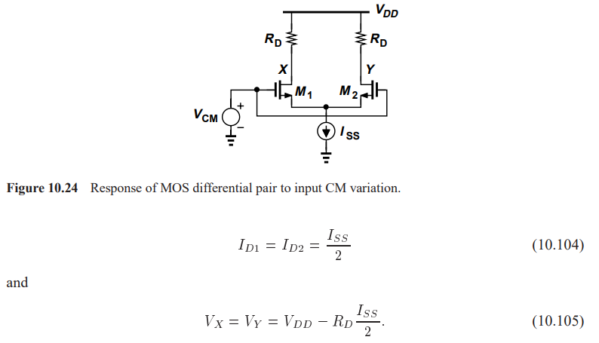
MOS Differential Pair Qualitative Analysis

Slide 27
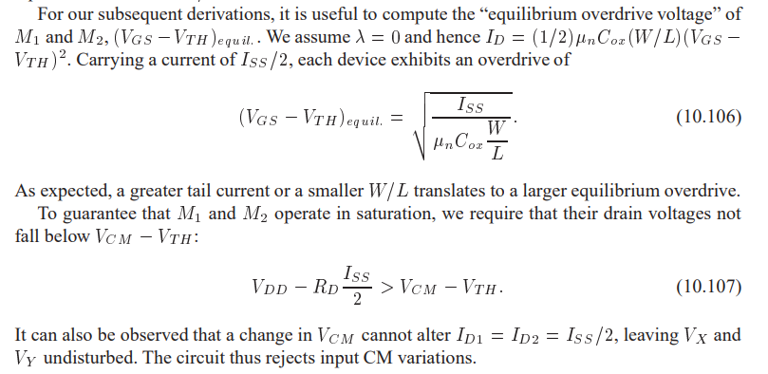

Slide 28
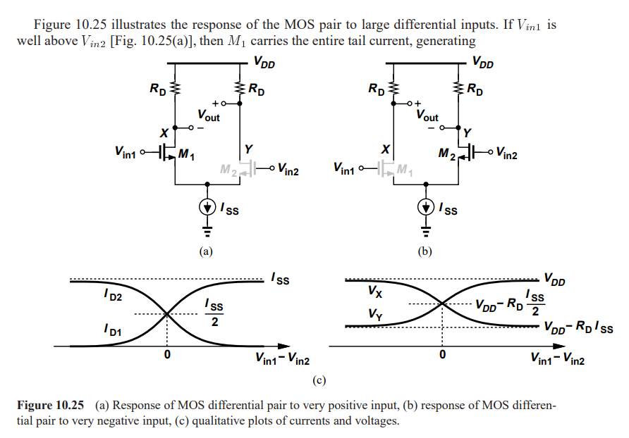

Slide 29
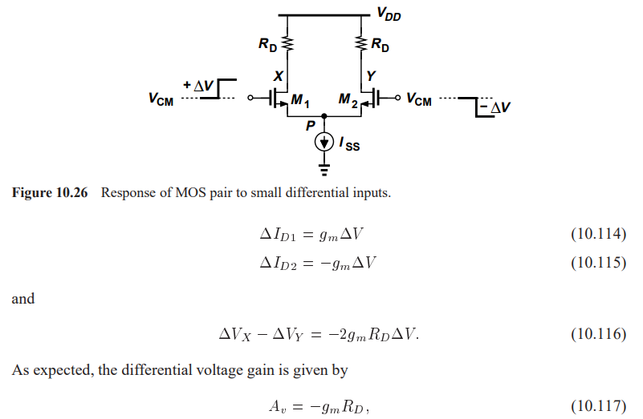

Slide 30
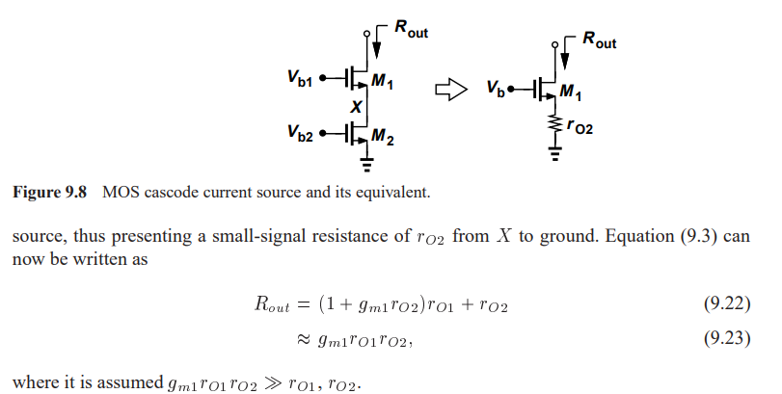
Cascode Differential Pair
Going back to Chapter 9 to under Cascode Amplifier
But why do we need to cascade ?

Slide 31
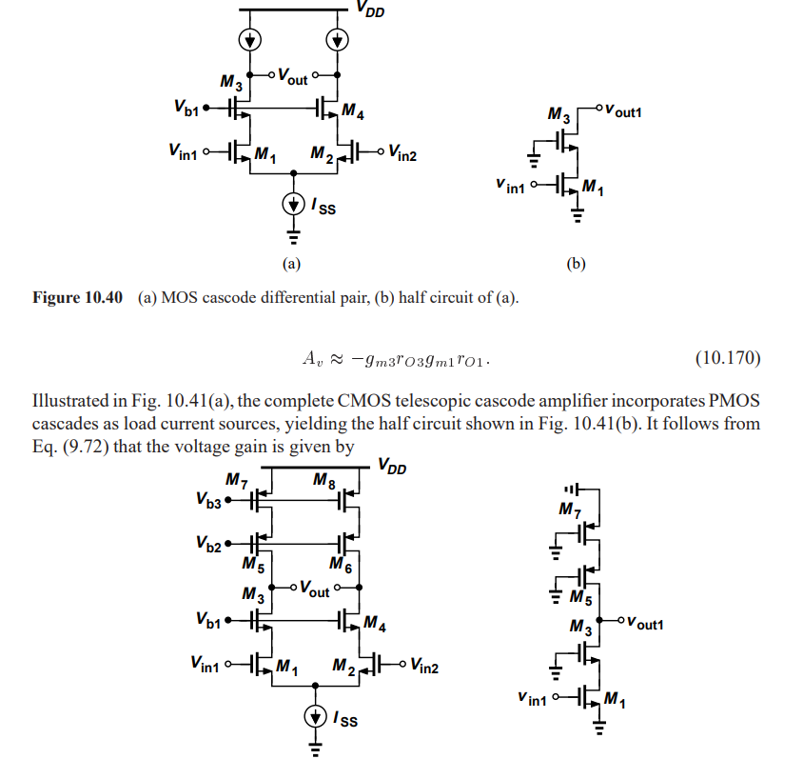

Slide 32
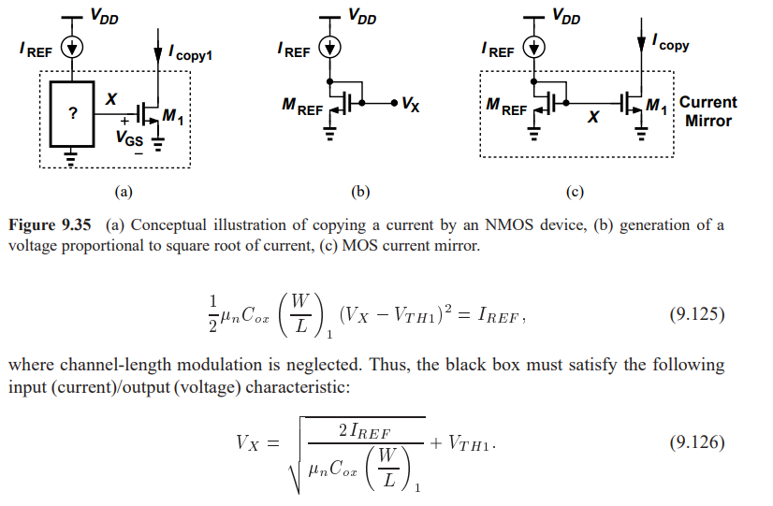
How to achieve current biasing

